Slide 1
Biodiversity in National Parks
Codecademy Portfolio Project for Data Science Pathway

Slide 2
Data
Data was downloaded from codecademy.com
Consists of two files:
species_info.csv
observations.csv

Slide 3
Data
Species_info.csv
Rows: 5824 rows of data, of which 5541 are unique
Columns:
  `category` - Class the species belongs to, seven different categories:
    `Mammal`, `Bird`, `Reptile`, `Amphibian`, `Fish`, `Vascular Plant`, `Nonvascular Plant`
  `scientific_name` - The species’ scientific name
  `common_names` - Names the species is commonly known as
  `conservation_status` - Conservation status of the species:
    `Endangered`, `Threatened`, `Species of Concern`, `In Recovery` and `NaN`

Slide 4
Data
Species_info.csv
The file had repeated species in different rows, which needed to be cleaned.
`conservation_status` had no value for species of least concern, so the value `Least Concern` so there are no empty values in the DataFrame
All columns are made up of nominal categorical data, except `conservation_status`, which consists of ordinal categorical data

Slide 5
Data
Observations.csv
Rows: 23296 rows of data, of which 5541 have unique scientific names, corresponding to the unique values of ‘species_nfo.csv’
Columns:
  `scientific_name` - Unique identifier with the species’ scientific name
  `park_name` - Name of the park where the observations were made:
    `Great Smoky Mountains National Park`, `Yosemite National Park`, `Bryce National Park` and `Yellowstone National Park`
  `observations` - Number of observations made for that species at that park

Slide 6
Data
Observations.csv
Some parks had multiple lines for the same scientific name, but it might be because they were recorded at different times, maybe different months or years, so I left them
`scientific_name` and `park_name` consist of nominal categorical data while `observations` is made up of discrete numerical data

Slide 7
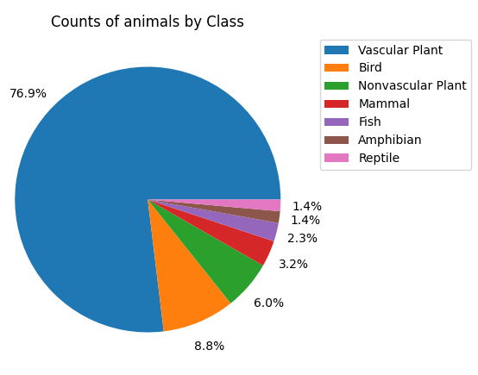
Analysis
`Vascular Plant` makes up the majority of the observations
`Bird` is the second biggest group
`Mammal`, `Fish`, `Amphibian` and `Reptile` all together account for 8.3% of the data recorded

Slide 8
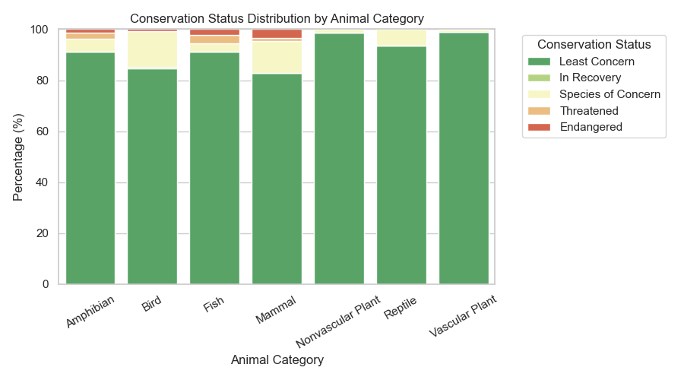
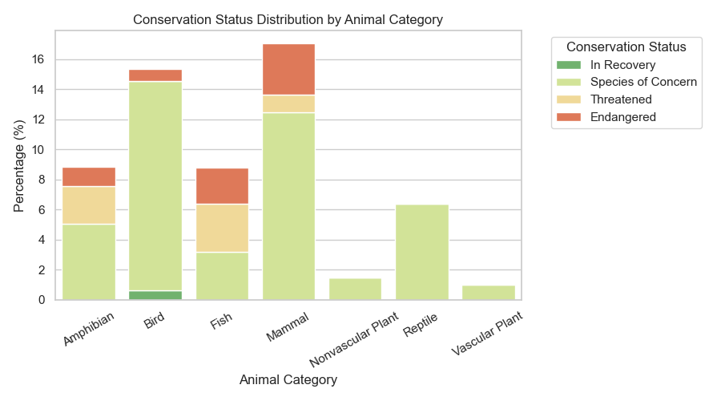
Analysis
Categories of least concern are `Vascular Plant`, `Nonvascular Plant`, `Reptile` and `Fish`
`Fish` also has a great number of `Endangered` and `Threatened` species

Slide 9
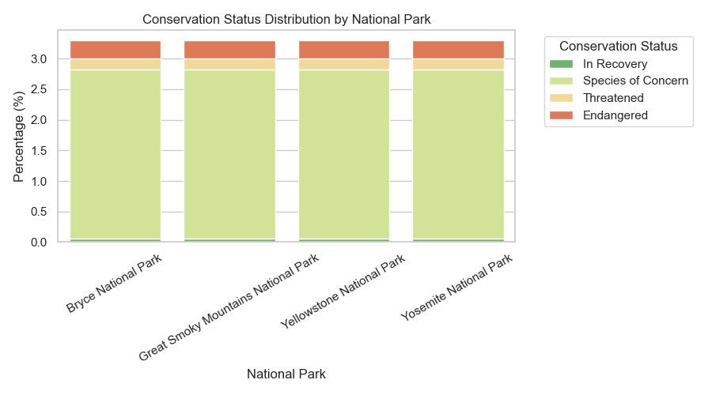
Analysis
All the species were seen at all parks, so no park has a higher number of endangered species than the others

Slide 10
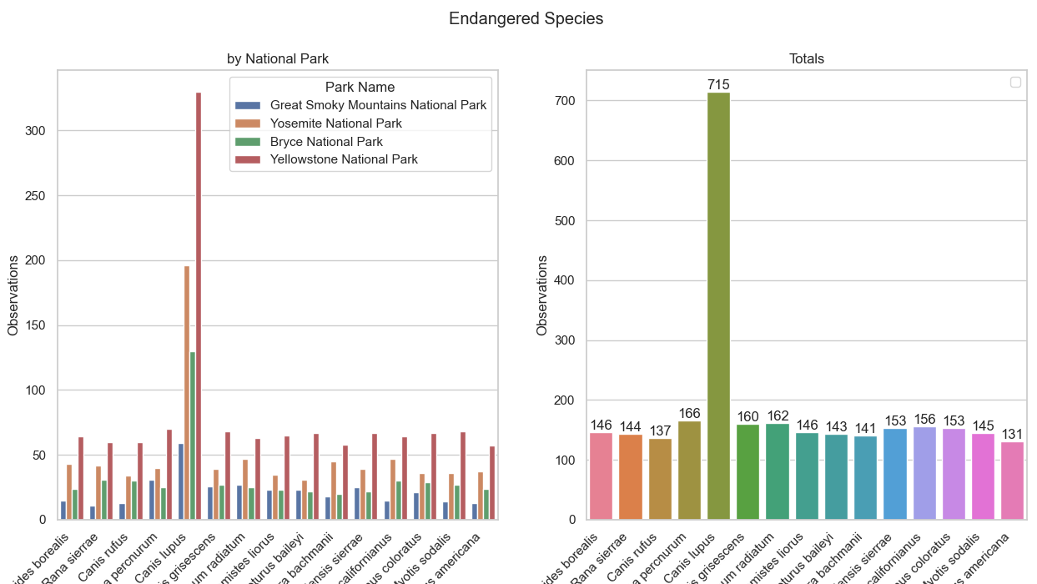
Analysis

Slide 11
Analysis
All the categories less seen species had similar numbers of observations
All these species were seen in all parks
Scientific Name | Observations | Category
Rana sierrae | 144 | Amphibian
Grus americana | 131 | Bird
Noturus baileyi | 143 | Fish
Canis rufus | 137 | Mammal
Geum radiatum | 162 | Vascular Plant

Slide 12
Analysis
Is the difference between a species category and their conservation status significant?
2 Categorical variables
Variables seemingly independent
Statistical Null hypothesis: There is no relationship between the two variables
Chi-square test

Slide 13
Analysis
Spread of conservation status across categories (in %)
Conservation Status | Endangered | In Recovery | Least Concern | Species of Concern | Threatened
Mammal | 3.41 | 0.00 | 82.95 | 12.50 | 1.14
Fish | 2.40 | 0.00 | 91.20 | 3.20 | 3.20
Amphibian | 1.27 | 0.00 | 91.14 | 5.06 | 2.53
Bird | 0.82 | 0.61 | 84.63 | 13.93 | 0.00
Vascular Plant | 0.02 | 0.00 | 98.92 | 1.01 | 0.05
Nonvascular Plant | 0.00 | 0.00 | 98.50 | 1.50 | 0.00
Reptile | 0.00 | 0.00 | 93.59 | 6.41 | 0.00
P-value: 0.00002 <0.01
Highly significant

Slide 14
Conclusion
All endangered species were seen in all parks, meaning there is a change for rehabilitation, but conservationist need to keep an eye out and active efforts must be built upon to achieve this
`Fish` is the category with most potential to get more endangered species, so rules and care should be put in place to try and reduce the decline of `Fish` population
A timestamp should be introduced to the data to further categorize and analyse it, making it possible to see how the individual species and even the categories are evolving within the parks

